Slide 1
MEET AI：From y=ax+b to ChatGPT
The Evolution of AI and Recent Breakthroughs
By: Yao Junchi, Xin Tianyu, Zhang Jiayuan

Slide 2
LLM Agent

Slide 3
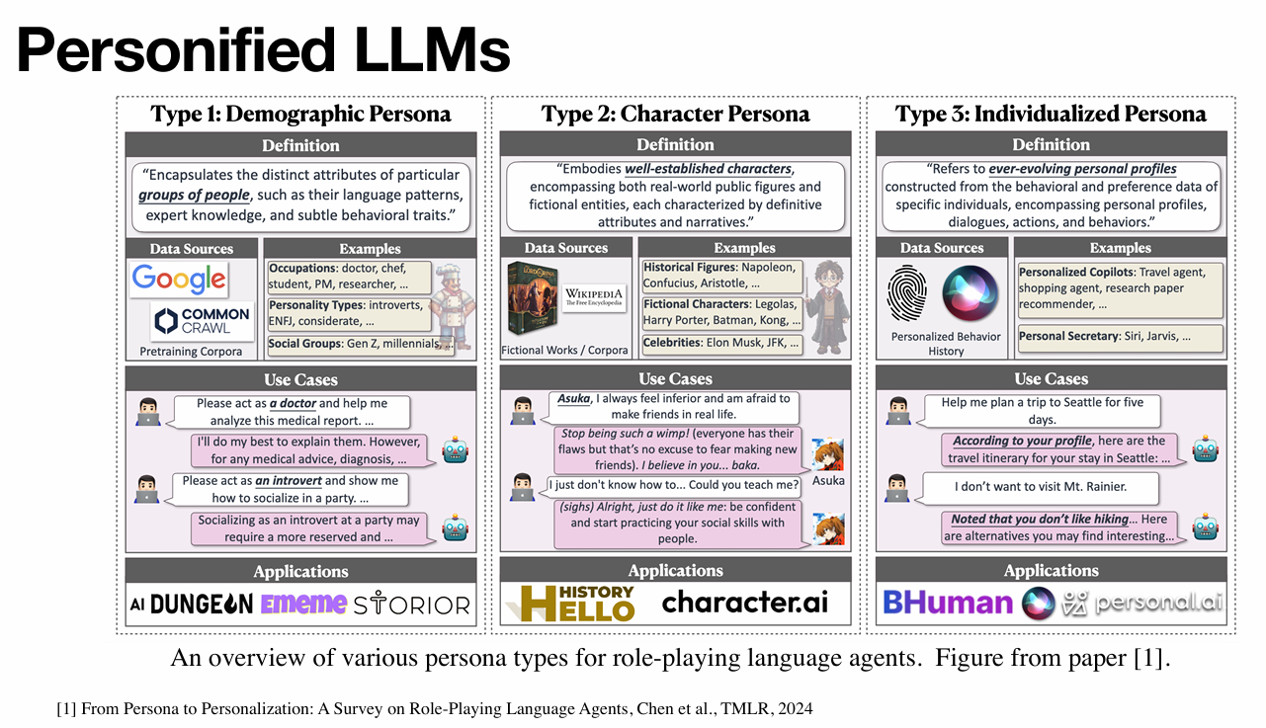

Slide 4
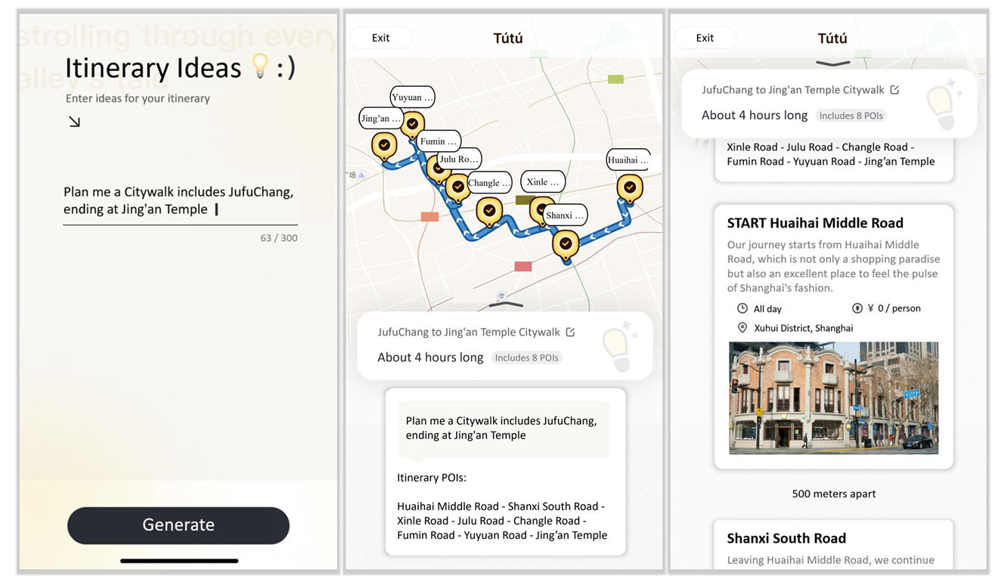

Slide 5
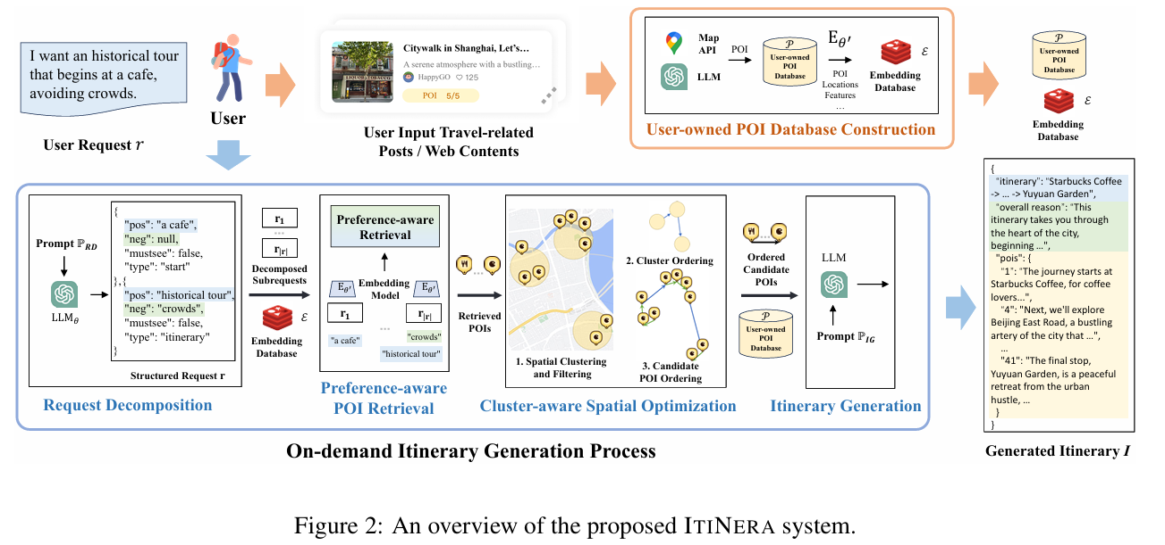

Slide 6
The Timeline of Deep Learning

Slide 7
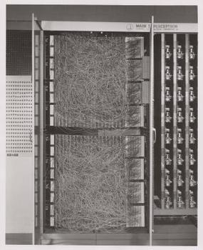


The Start of Neural Network: Multilayer Perception (late 1960s)
MLP:
x
y
$$y=\left\{\begin{aligned}ax+b, ax+b≥0 \\ 0, ax+b<0\end{aligned}\right.$$
$$y=max⁡\{aX+b, 0\}$$
Multilayer Perceptron
Late 1960s

Slide 8
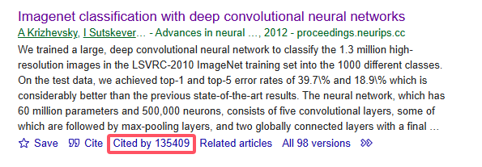
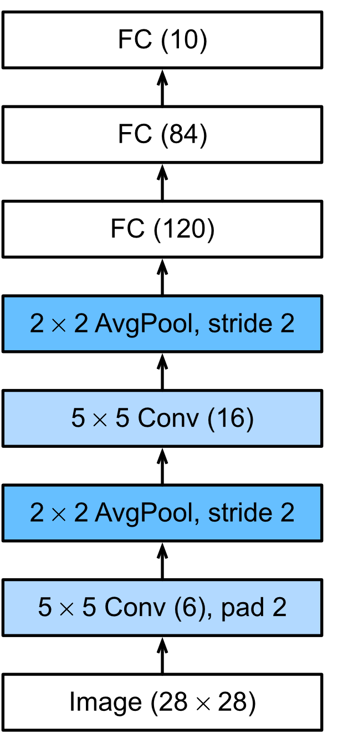
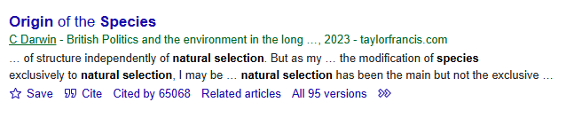
The Start of Deep Learning——popularizing CNN: AlexNet (2012)
AlexNet paper:
Origin of the Species (进化论) paper:
Image classification
Multilayer Perceptron
AlexNet
Late 1960s
2012

Slide 9
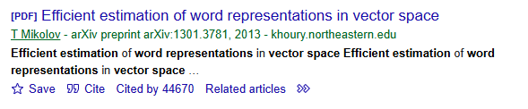
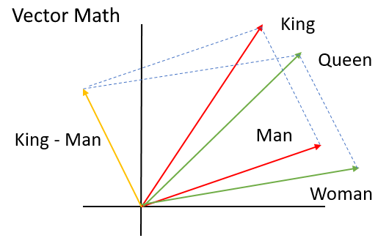
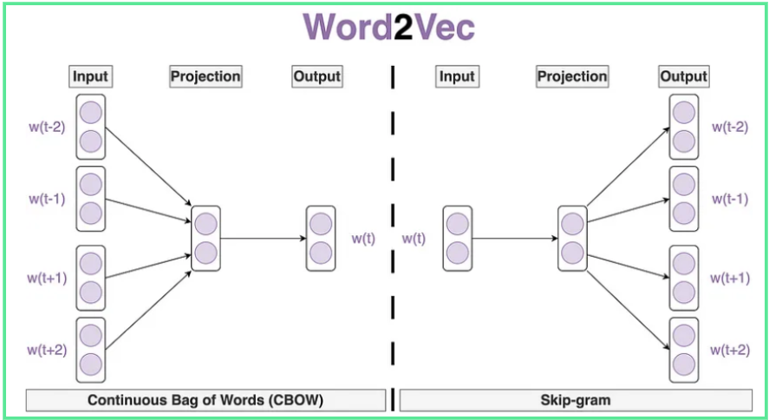
The Start of Modern Language Processing——Word to Vector: Word2Vec (2013)
Word2Vec paper:
Natural Language Processing (NLP)
Image classification
Multilayer Perceptron
AlexNet
Word2Vec
Late 1960s
2012
2013

Slide 10
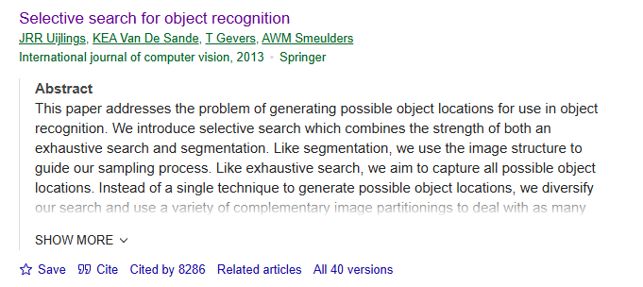
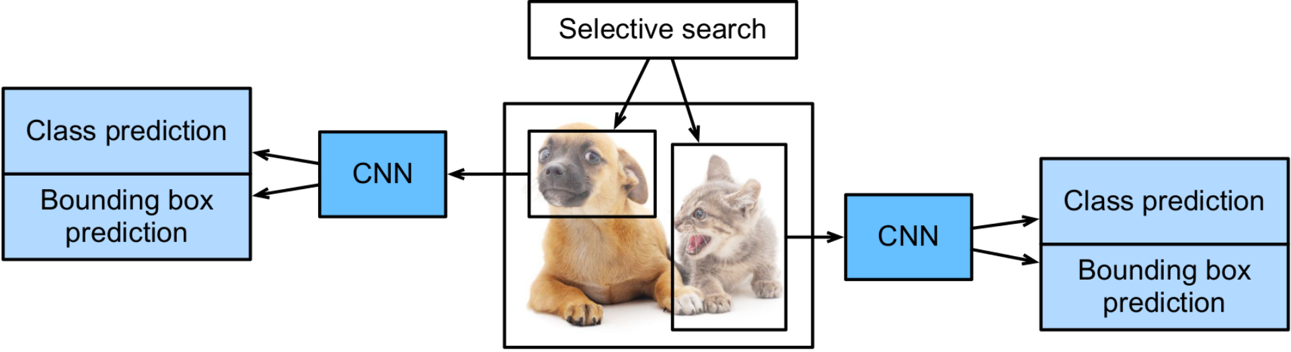
The Start of Object Detection——Region-based CNN: R-CNN (2014)
R-CNN paper:
Natural Language Processing (NLP)
Image classification
Object detection
Multilayer Perceptron
AlexNet
Word2Vec
R-CNN
Late 1960s
2012
2013
2014

Slide 11
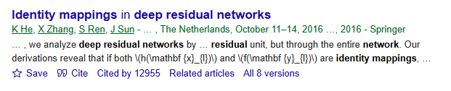
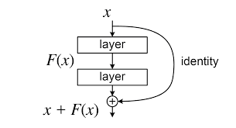
The Start of large models——Deep Residual Networks: ResNet (2016)
ResNet paper:
Natural Language Processing (NLP)
Image classification
Object detection
Multilayer Perceptron
AlexNet
Word2Vec
R-CNN
ResNet
Late 1960s
2012
2013
2014
2016

Slide 12
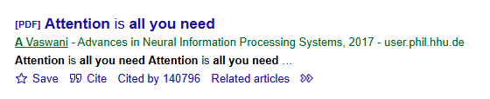

A Big Breakthrough——Attention is all you need: Transformer (2017)
Transformer paper:
Natural Language Processing (NLP)
Image classification
Object detection
Multilayer Perceptron
AlexNet
Word2Vec
R-CNN
ResNet
Transformer
Late 1960s
2012
2013
2014
2016
2017

Slide 13
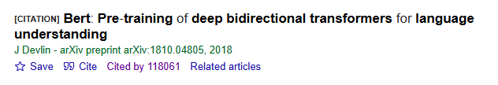
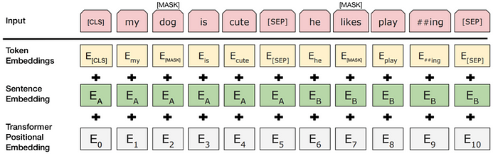
Start of chatbots——Bidirectional Encoder Representations from Transformers: Bert (2018)
Bert paper:
Natural Language Processing (NLP)
Large Language Models (LLM)
Image classification
Object detection
Multilayer Perceptron
AlexNet
Word2Vec
R-CNN
ResNet
Transformer
Bert
Late 1960s
2012
2013
2014
2016
2017
2018

Slide 14
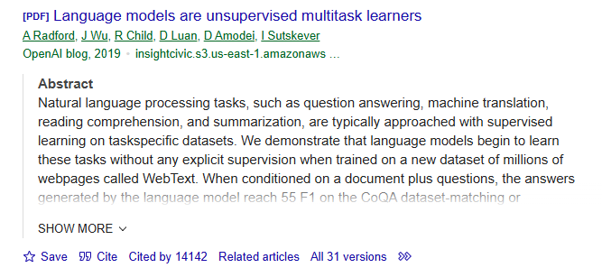
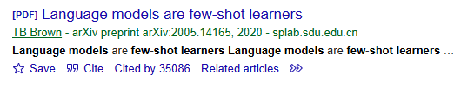
The Expansion of Large Language Models
GPT-3 paper:
GPT-2 paper:
Natural Language Processing (NLP)
Large Language Models (LLM)
Image classification
Object detection
Multilayer Perceptron
AlexNet
Word2Vec
R-CNN
ResNet
Transformer
Bert
GPT-2
GPT-3
……
Late 1960s
2012
2013
2014
2016
2017
2018
2019
2020

Slide 15
Large Language Model
大语言模型

Slide 16
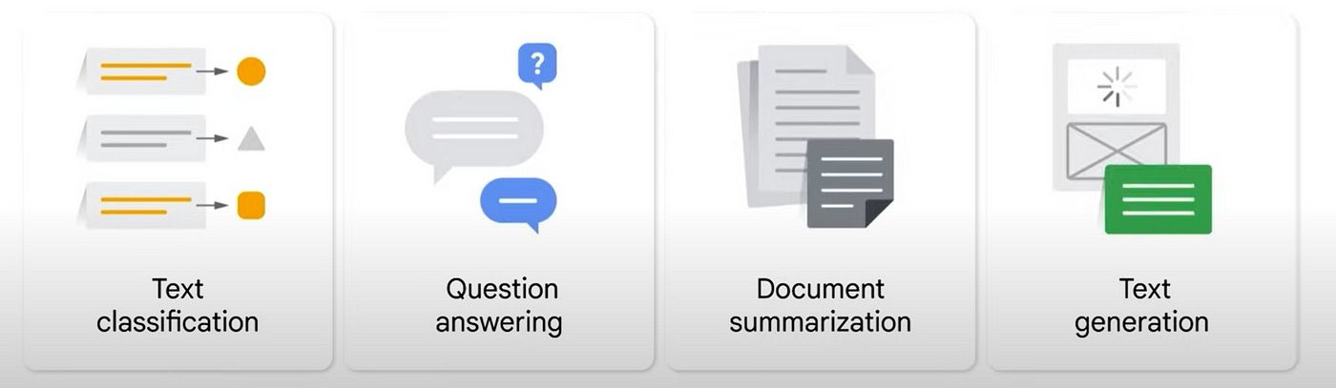







Examples includes gpt, claude, 文心一言

Slide 17
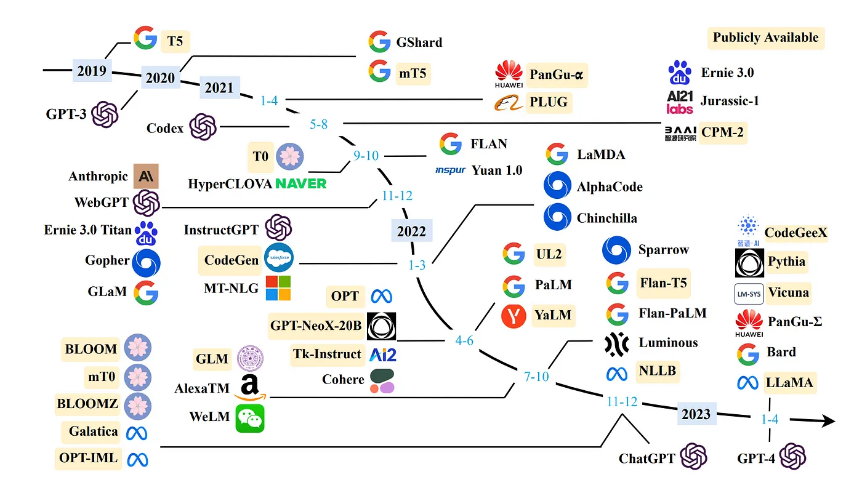

Slide 18
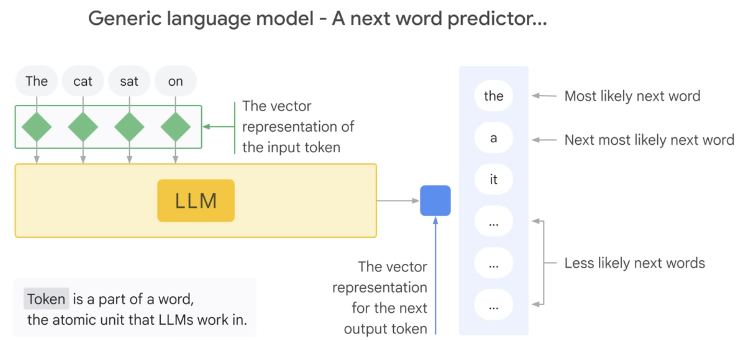
Workflow
Tokenization, prediction, select (and input next token)

Slide 19
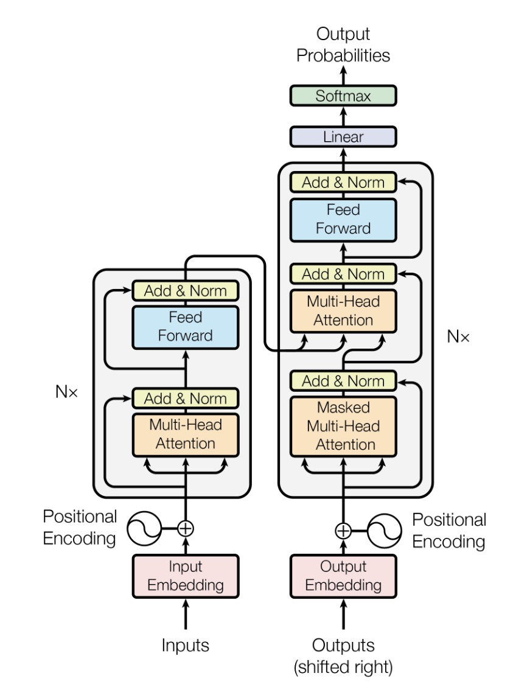
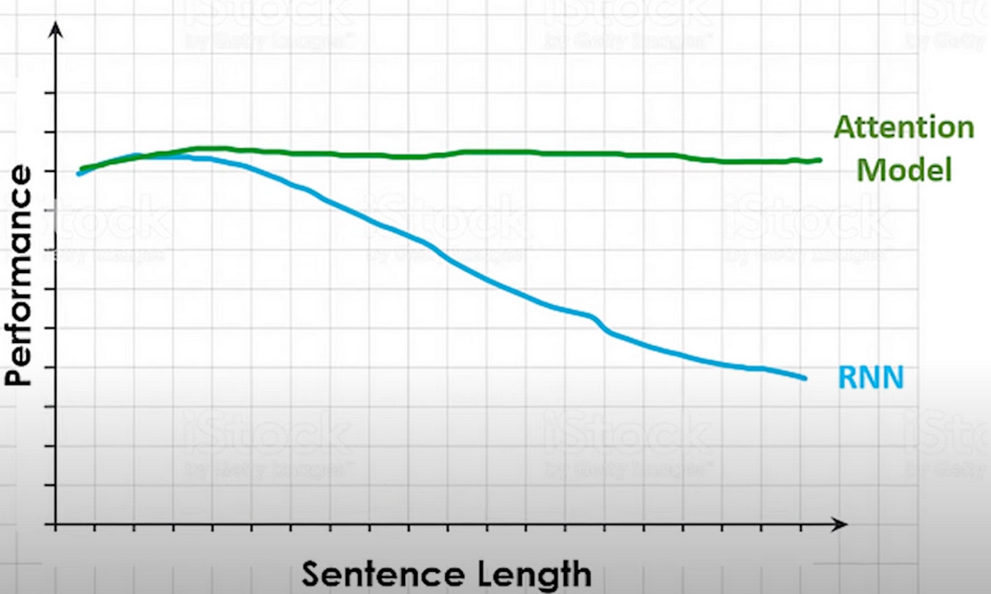
Architecture inside LLM
Sequence input, RNN, transformer

Slide 20
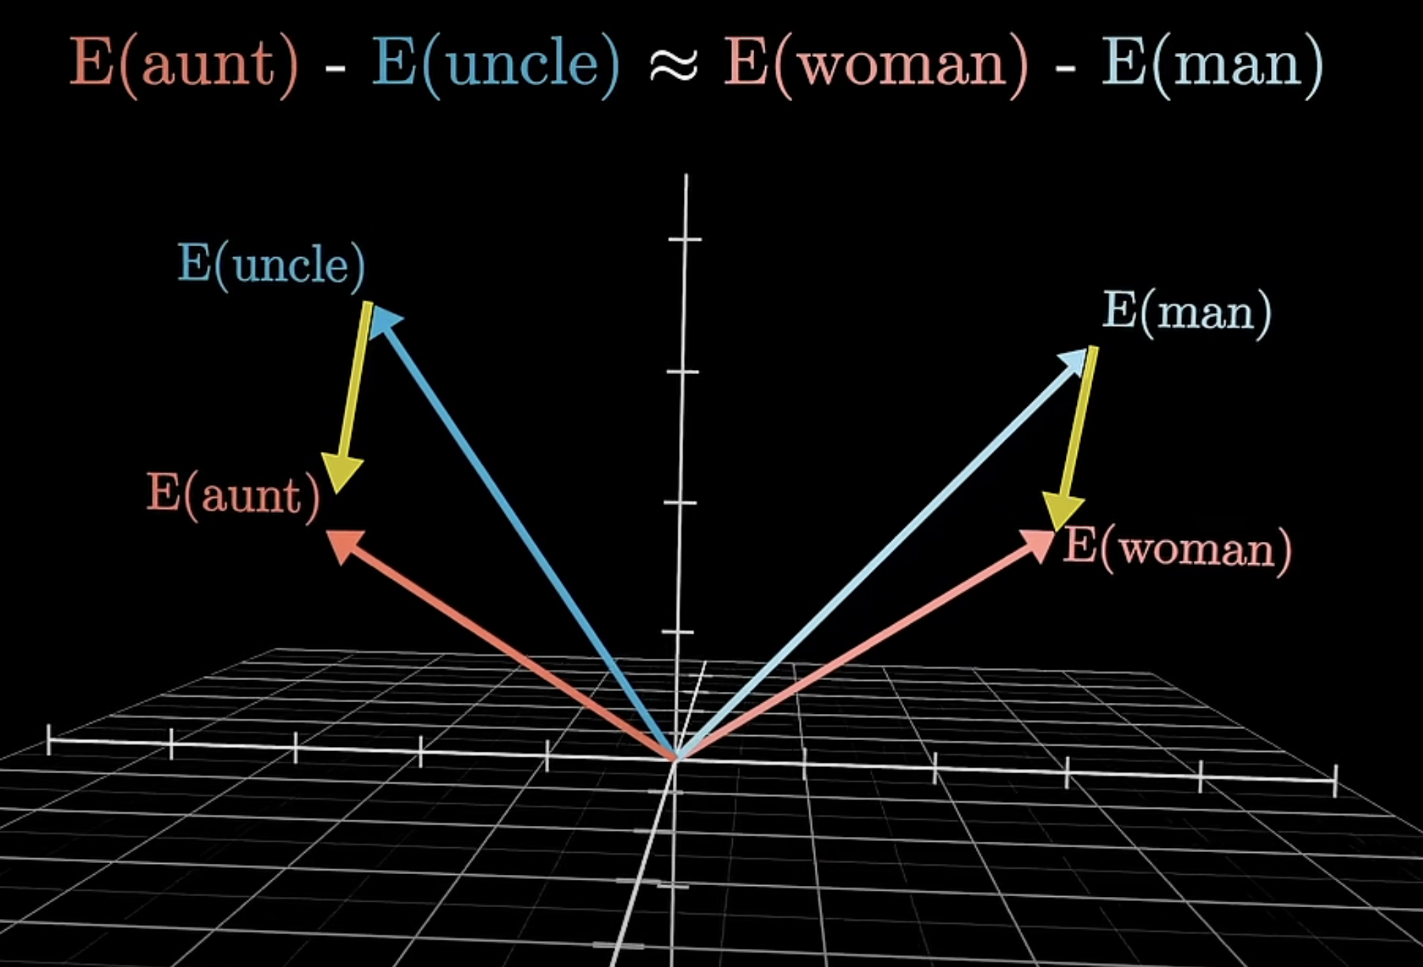
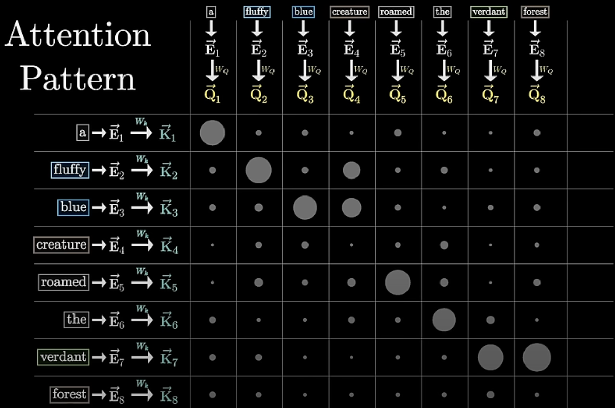
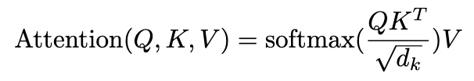
Architecture inside LLM
Token Embedding
Attention Mechanism

Slide 21
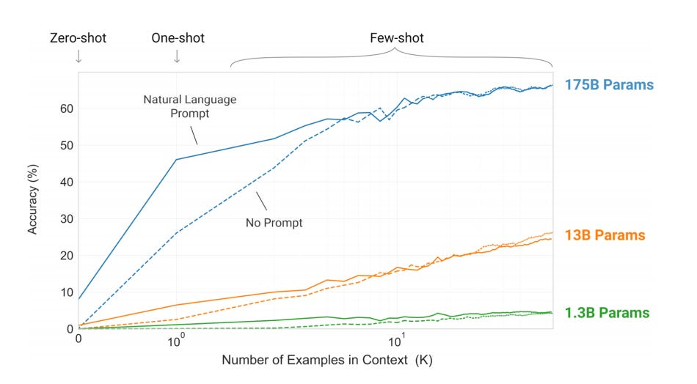
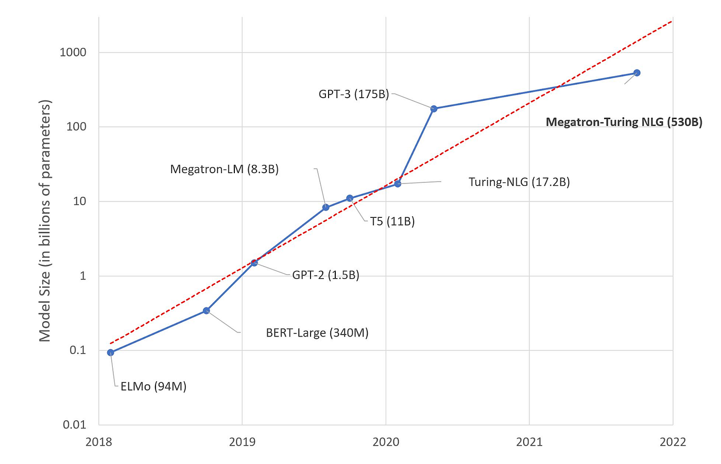
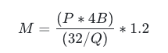
Large?
Model Size
Accuracy
Example: 7B model – 14.7GB

Slide 22
Multi-Modal
多模态

Slide 23
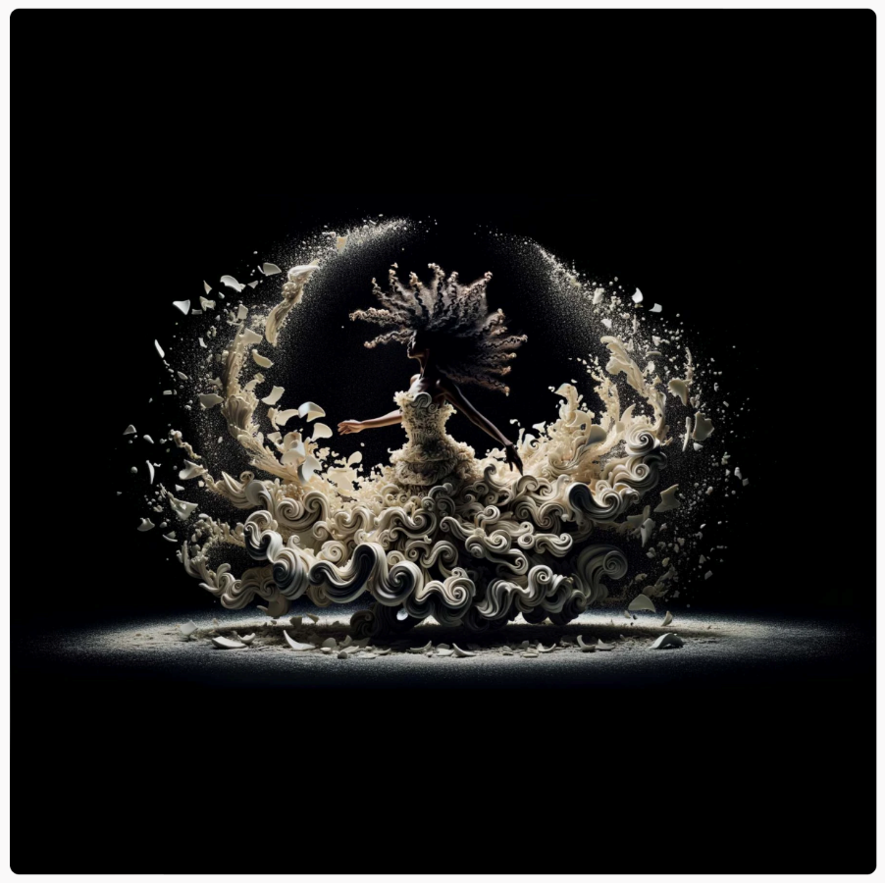
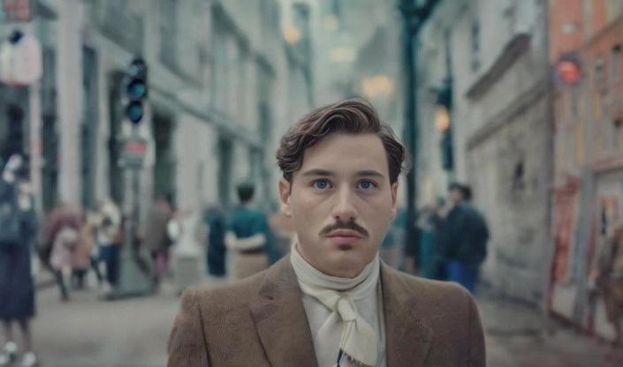
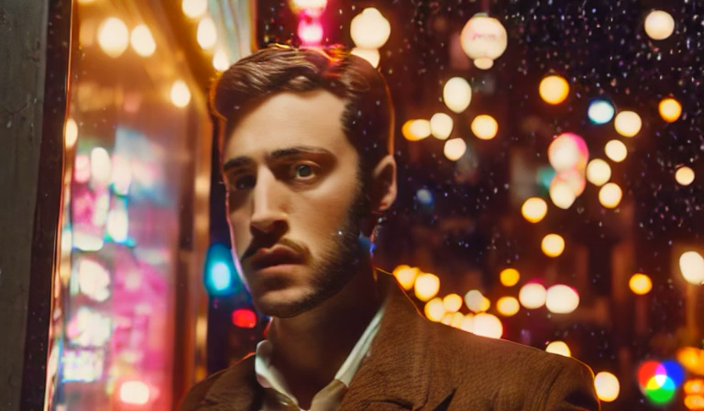


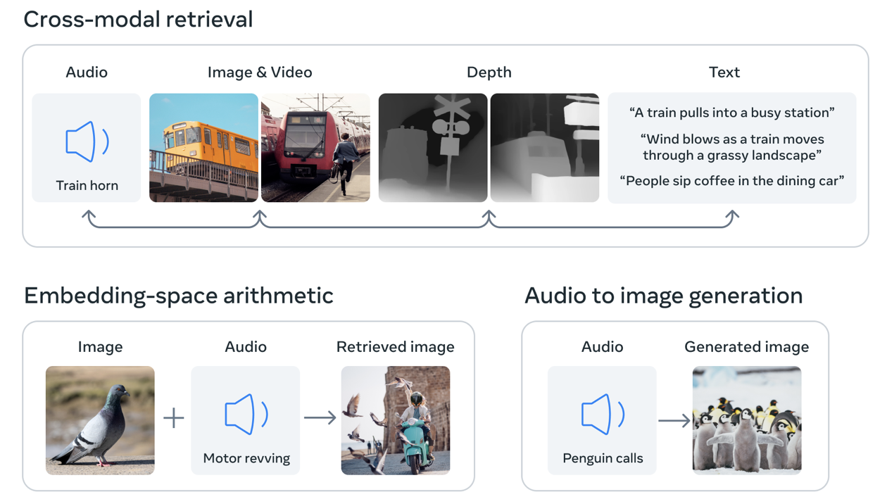
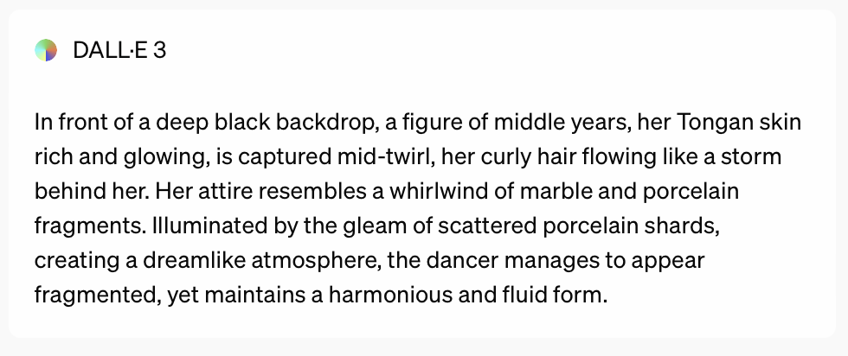

Multi-Modal -- Dealing with several modality
Text to Image
Text + Image to Video
Audio-Related

Slide 24
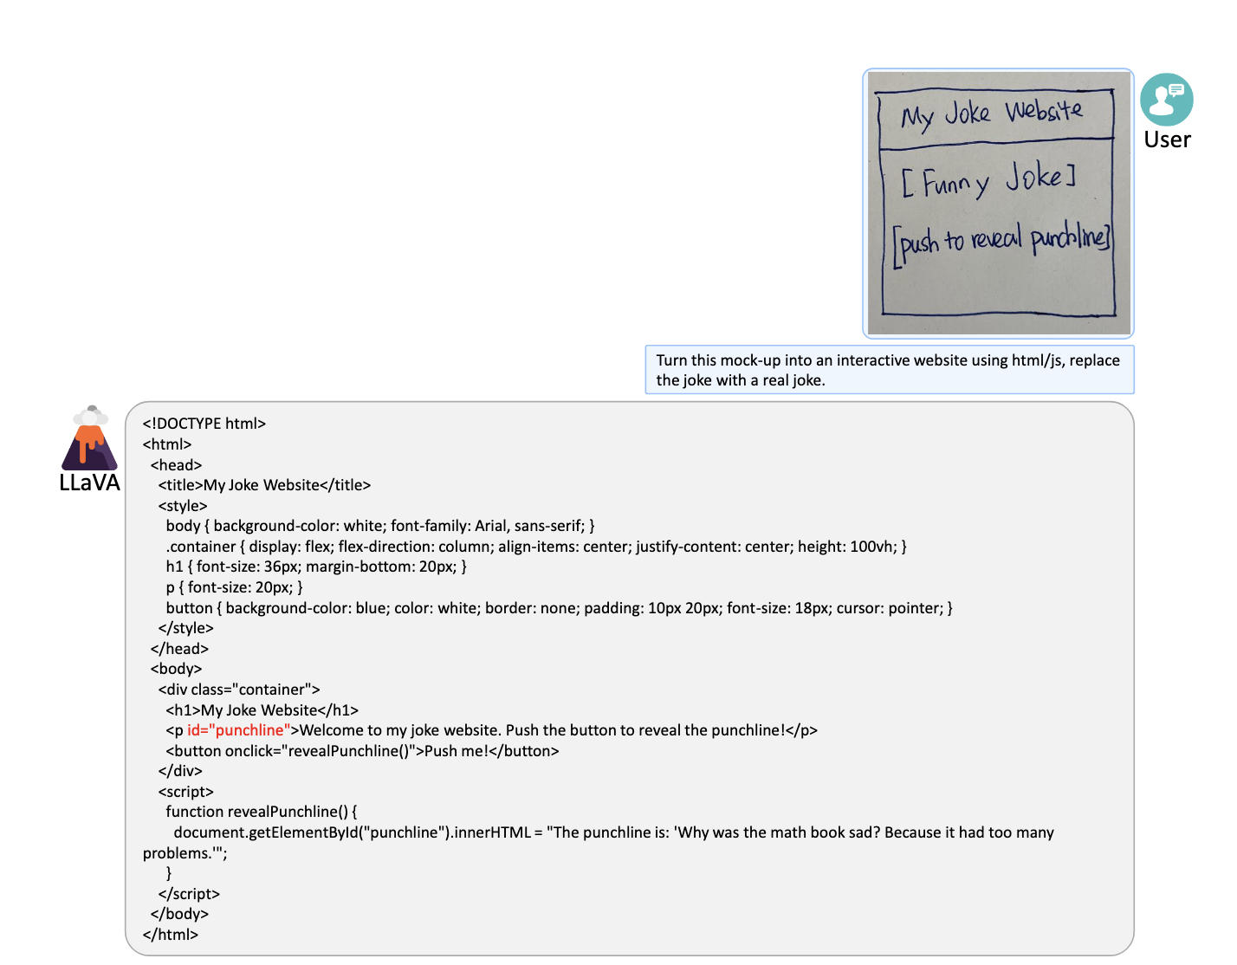
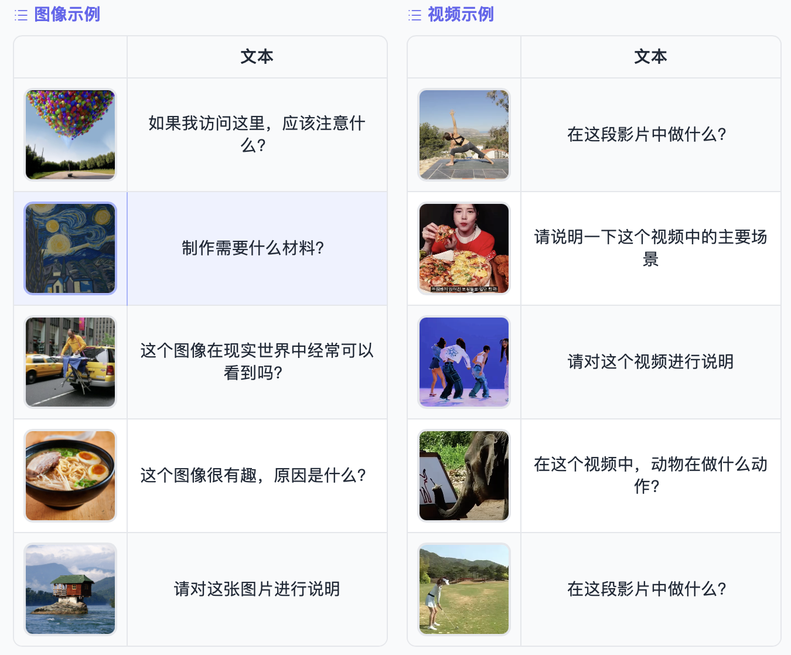
Example – Vision Language Model
Image + Text – Text

Slide 25
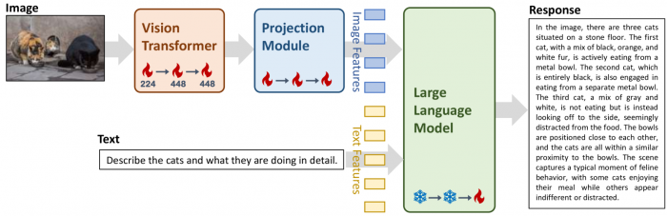
Example – Vision Language Model
Image + Text – Text
The image is firstly encoded and then projected

Slide 26
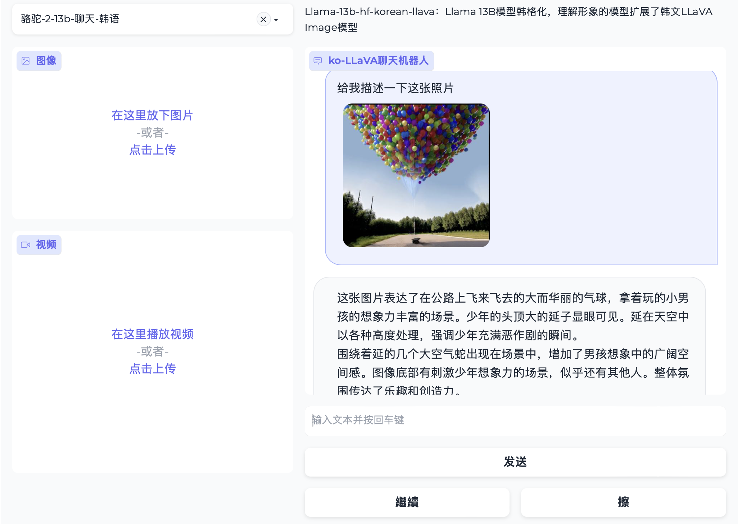
Example – Vision Language Model
Image + Text – Text
https://huggingface.co/spaces/etri-vilab/Ko-LLaVA

Slide 27
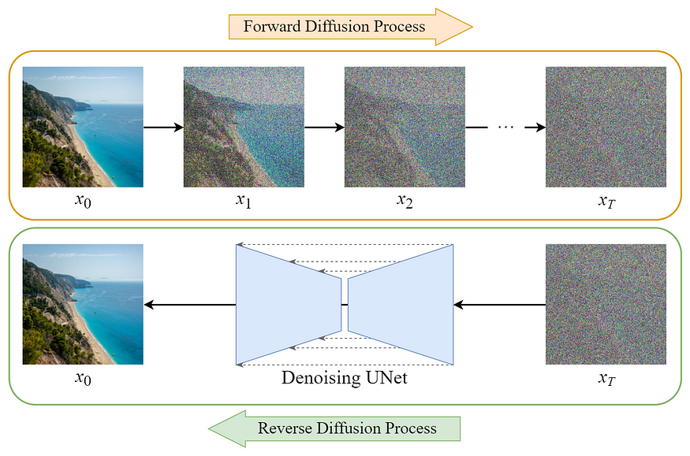
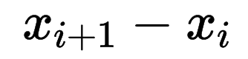
Example – Stable Diffusion
Text – Image
Training
学习
Test
随机高斯图像
生成图像
Ink-like Diffusion Process

Slide 28
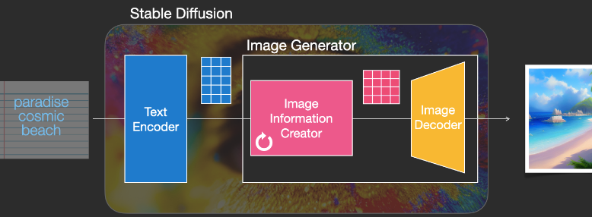
Example – Stable Diffusion
Text – Image
Text Control
Vision Encoder/Decoder
https://huggingface.co/spaces/stabilityai/stable-diffusion

Slide 29
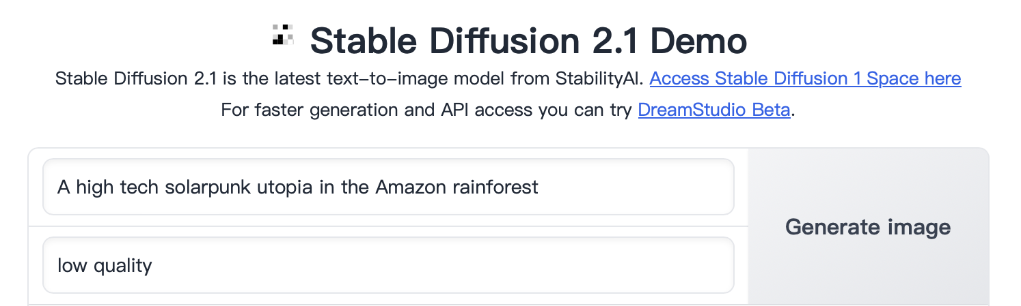
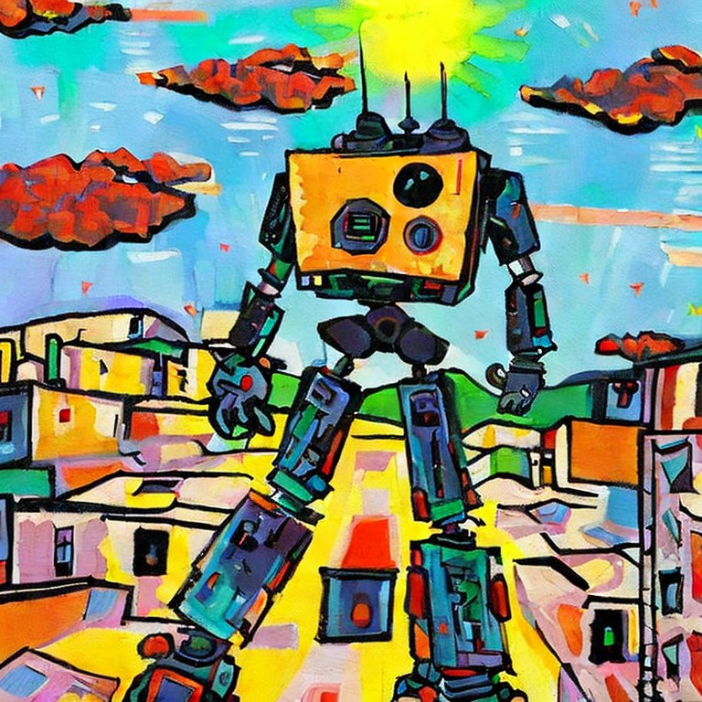
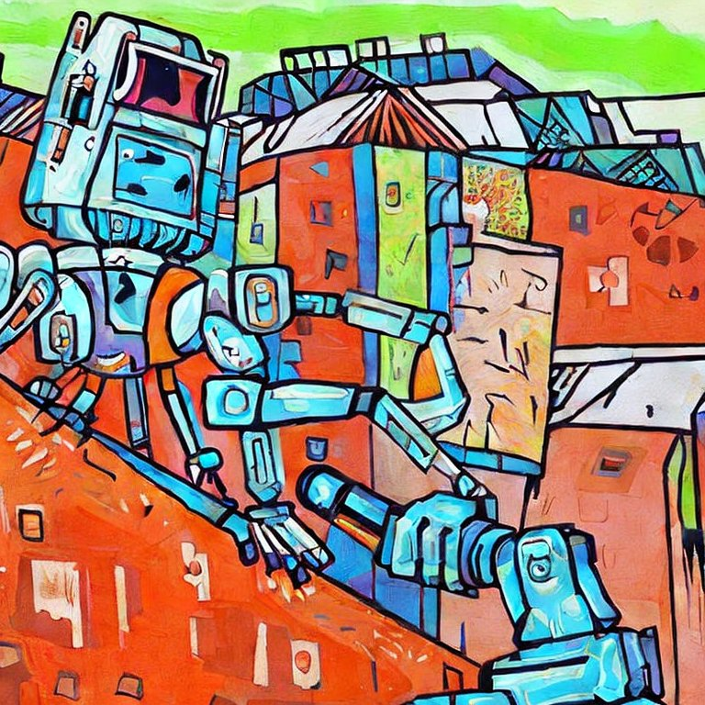
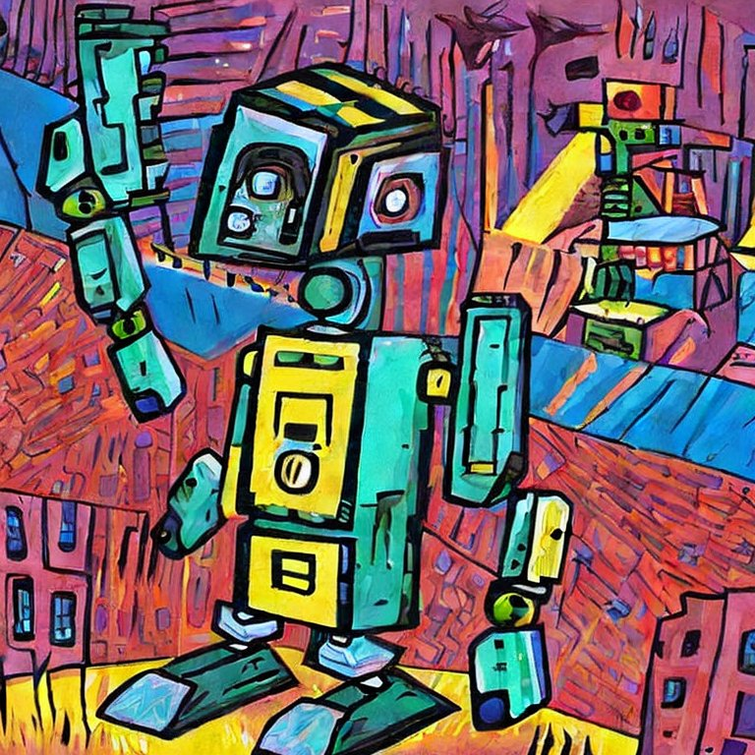
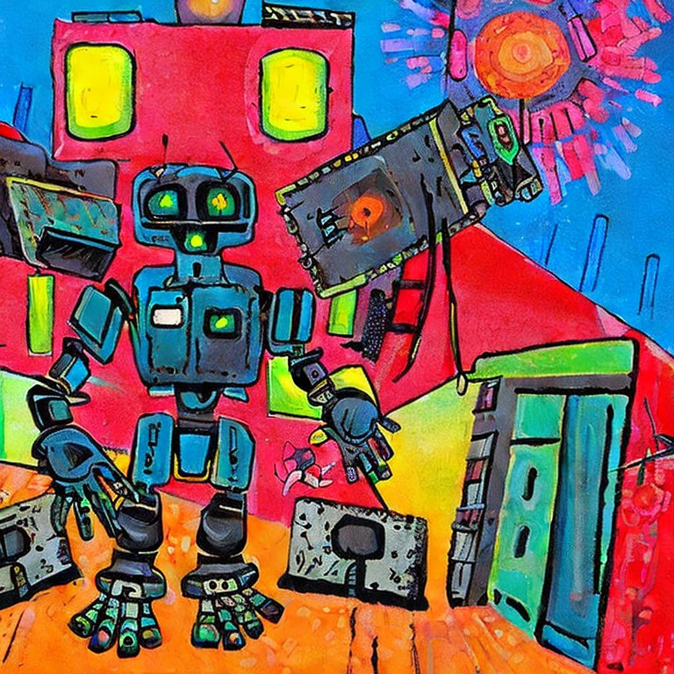
Example – Stable Diffusion
Text – Image
https://huggingface.co/spaces/stabilityai/stable-diffusion

Slide 30
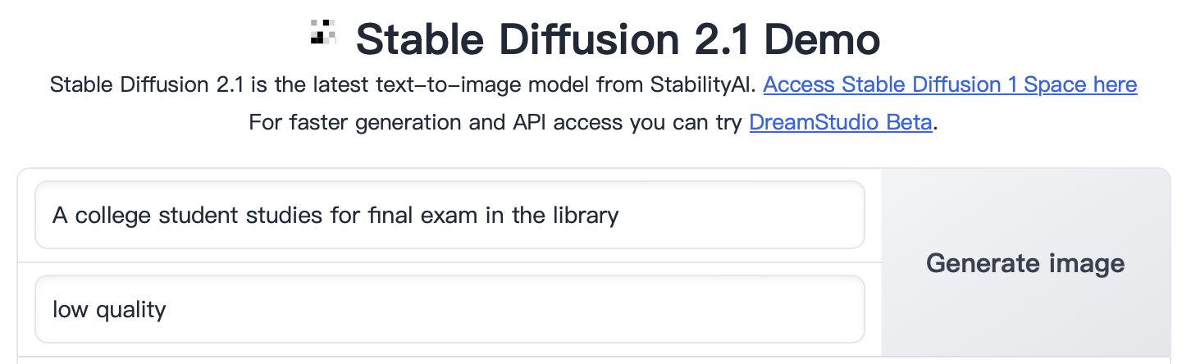
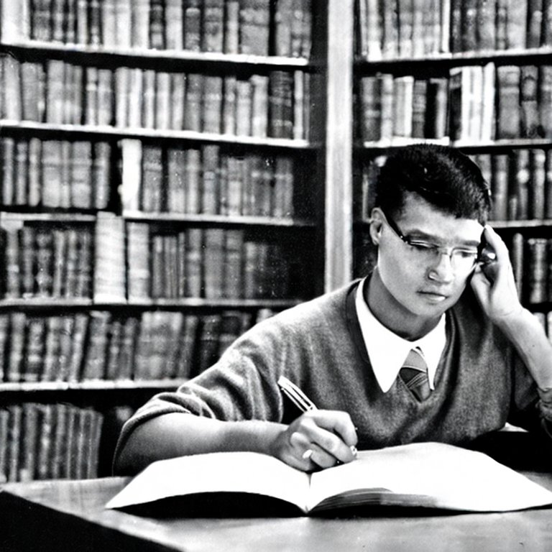

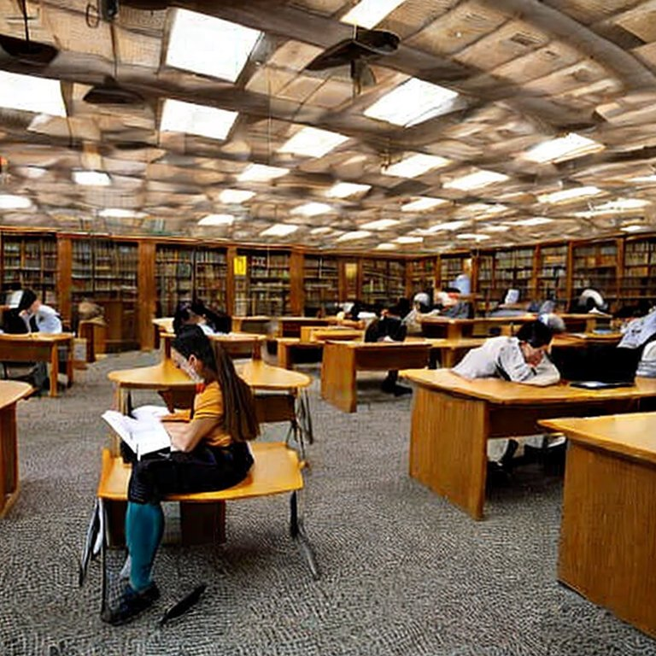

Example – Stable Diffusion
Text – Image
https://huggingface.co/spaces/stabilityai/stable-diffusion

Slide 31





Reinforcement Learning

Slide 32
Different areas of AI
Computer Vision (CV)
Embodied Intelligence
Natural Language Processing (NLP)
AI4S: AI for Science
General Machine Learning
Reinforcement Learning
Explainable Machine Learning
……
Natural Language Processing (NLP)
Large Language Models (LLM)
Image classification
Object detection
Multilayer Perceptron
AlexNet
Word2Vec
R-CNN
ResNet
Transformer
Bert
GPT-2
GPT-3
……
Late 1960s
2012
2013
2014
2016
2017
2018
2019
2020

Slide 33
Thanks for listening!

